Slide 1
CRIX (crypto currencies index)
0852628 Dwilaksana Abdullah Rasyid

Slide 2

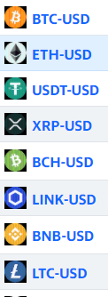
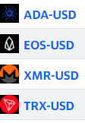
Download the data from Yahoo Finance
12 crypto currencies
Download 3 variables, price, volume and market cap
Start from 17/09/2014 until 29/10/2020

Slide 3
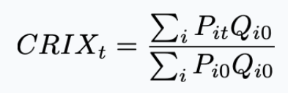
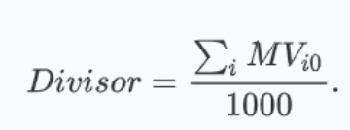
From https://thecrix.de/#Methodology to see the indexing calculation of crypto currencies
P_{it} the price of the crypto i at time point t
Q_{i0} the amount of crypto i at time point 0
P_{i0} is the price at time point 0
MV_{it} is the market capitalization of the crypto i

Slide 4
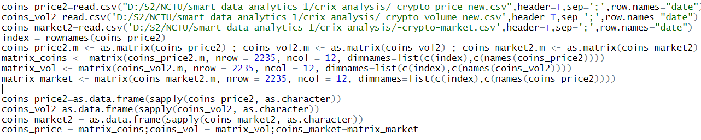
Calculate CRIX with Code From Github
https://github.com/QuantLet/CRIX/tree/master/CRIXcode
Run CRIXcodehelper.R first
Make the new dataset look like previous dataset (large matrix)

Slide 5
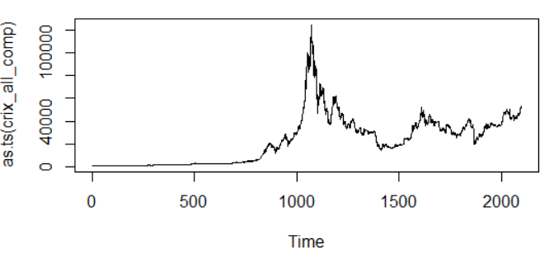
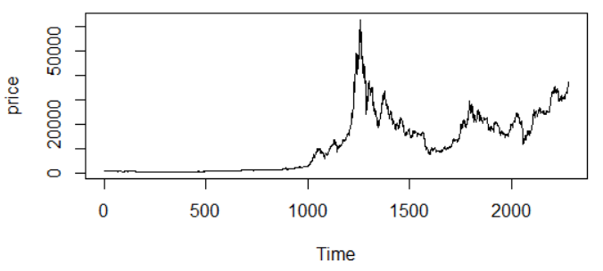
Crix with12 crypto currencies
From yahoo finance
Crix from https://thecrix.de/
The y axis on left image is bigger than y axis from https://thecrix.de/
It’s because there are some error to calculate the quantile from ‘NA’ data

Slide 6
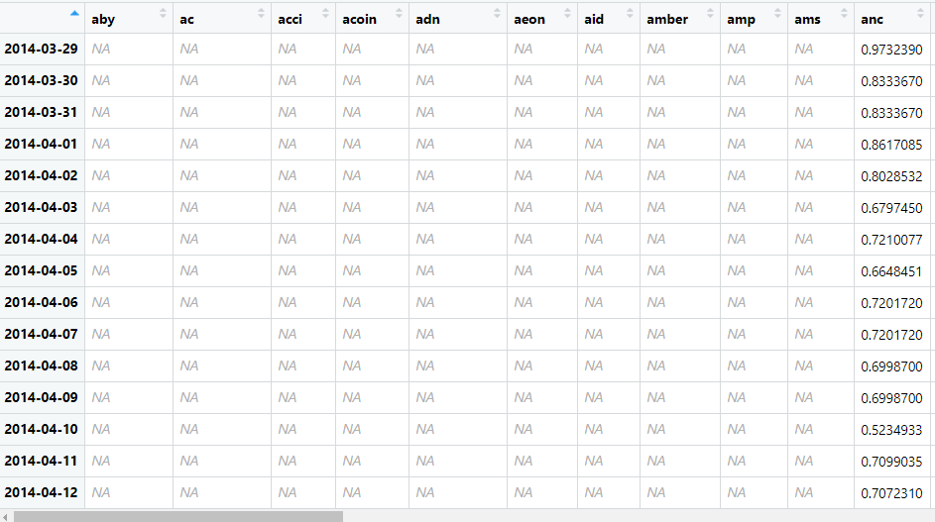
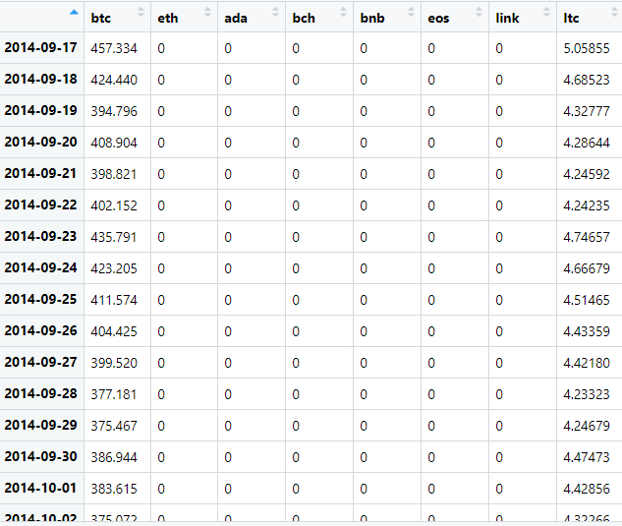
Previous dataset from
github.com/QuantLet/CRIX/tree/master/CRIXcode
New Dataset from Yahoo Finance
‘NA’ observation change to ‘0’ because there are some error
to calculate quantile.

